Slide 1
TABLEAU AND POWER BI
ASSIGNMENT-1

Slide 2
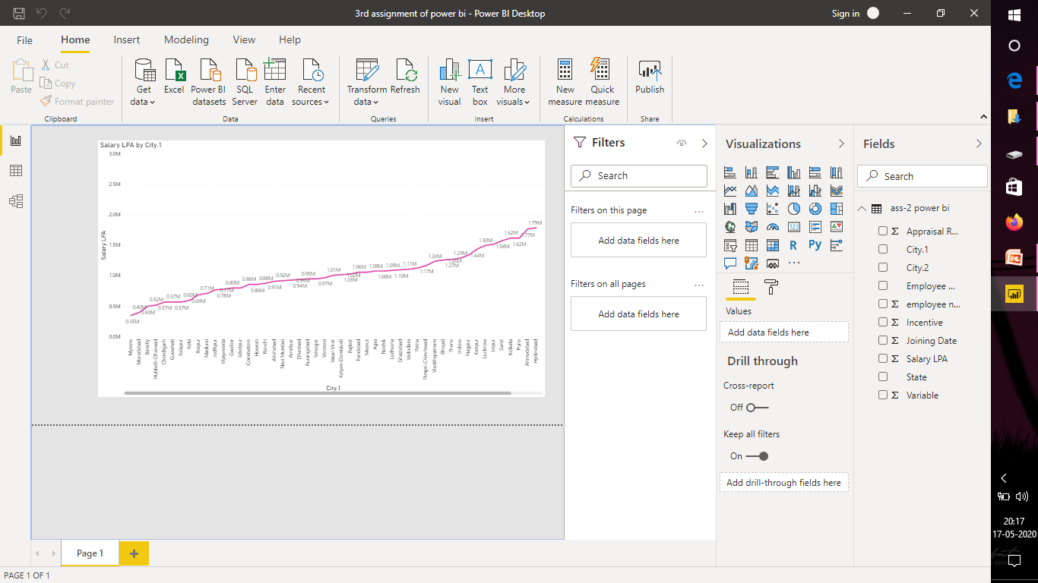
REPORT VIEW PAGE

Slide 3
REPORT VIEW

Slide 4
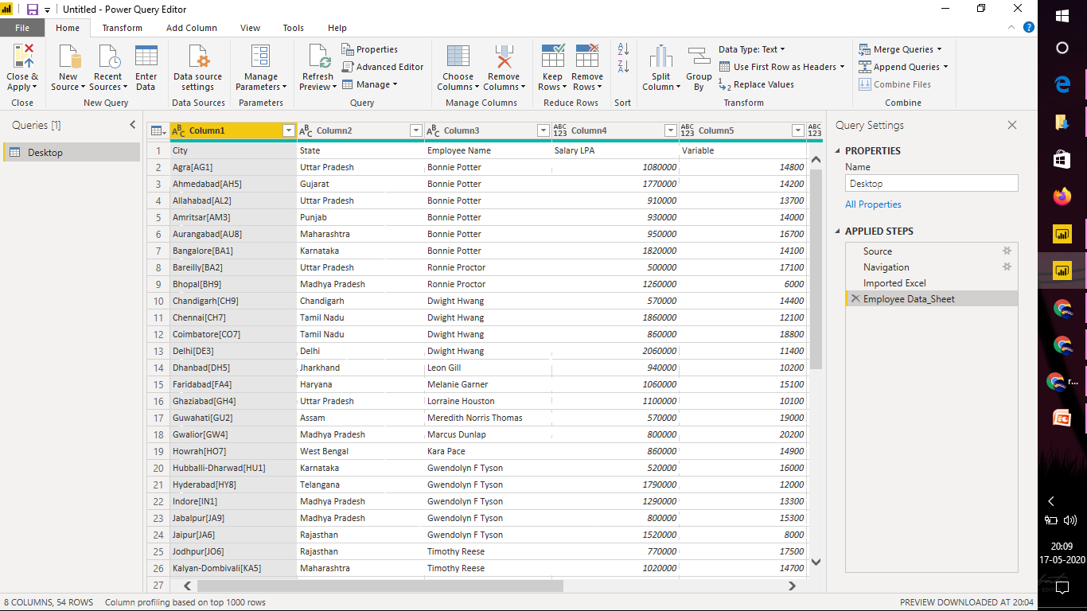
DATA VIEW

Slide 5
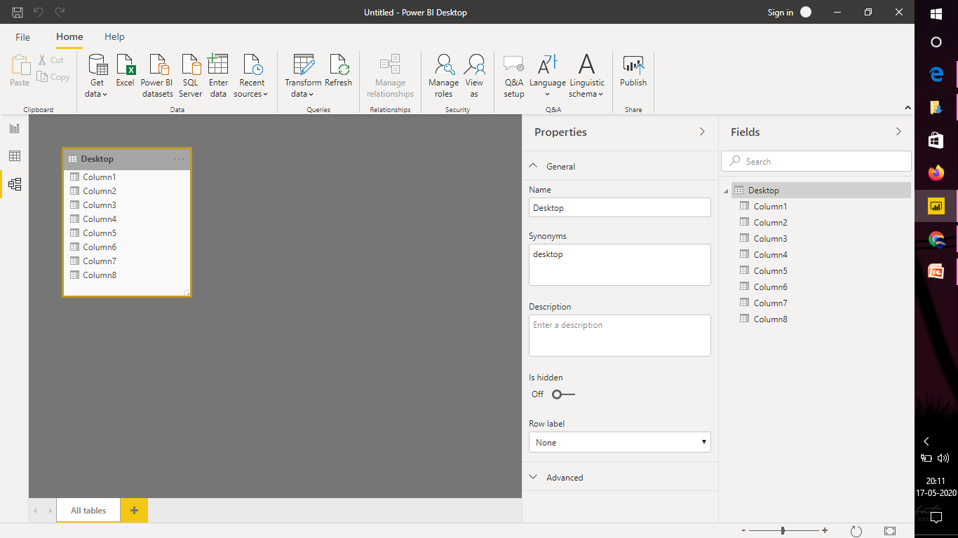
MODEL VIEW

Slide 6
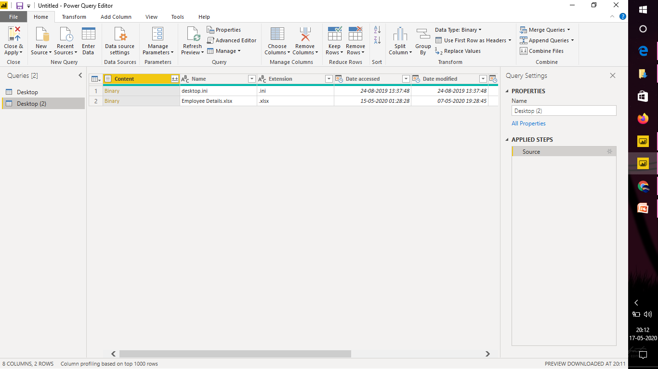
POWER QUERY EDITOR

Slide 7
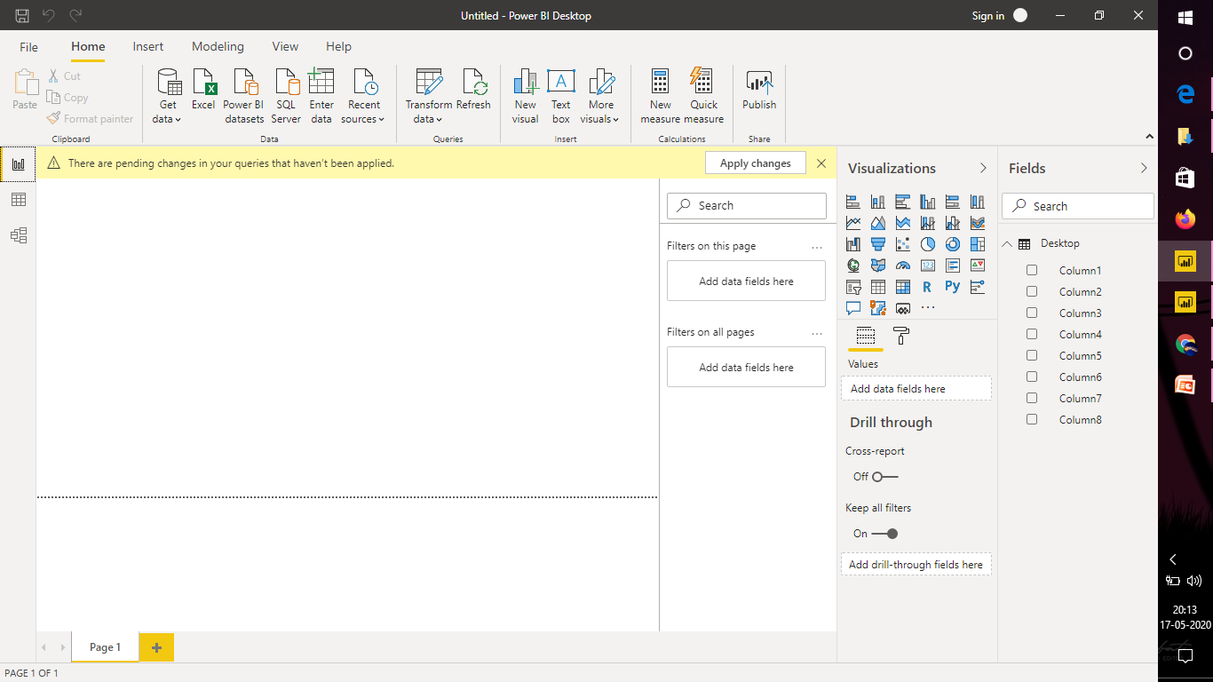
ADVANCED EDITOR

